Slide 1

Module 3: Classification
Sep 20th, 2021

Slide 2
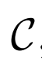

Classification
Qualitative variables take values in an unordered set
Such as
Given a feature vector X and a qualitative response Y in the set C, the classification task is to find a function (classifier) C(X) that takes X as input and predict its value for Y;
Often, we are more interested in estimating the probabilities that X belongs to each category in
For example: we want to predict whether COVID19 vaccine will work or not on a patient given patient’s age.

Slide 3
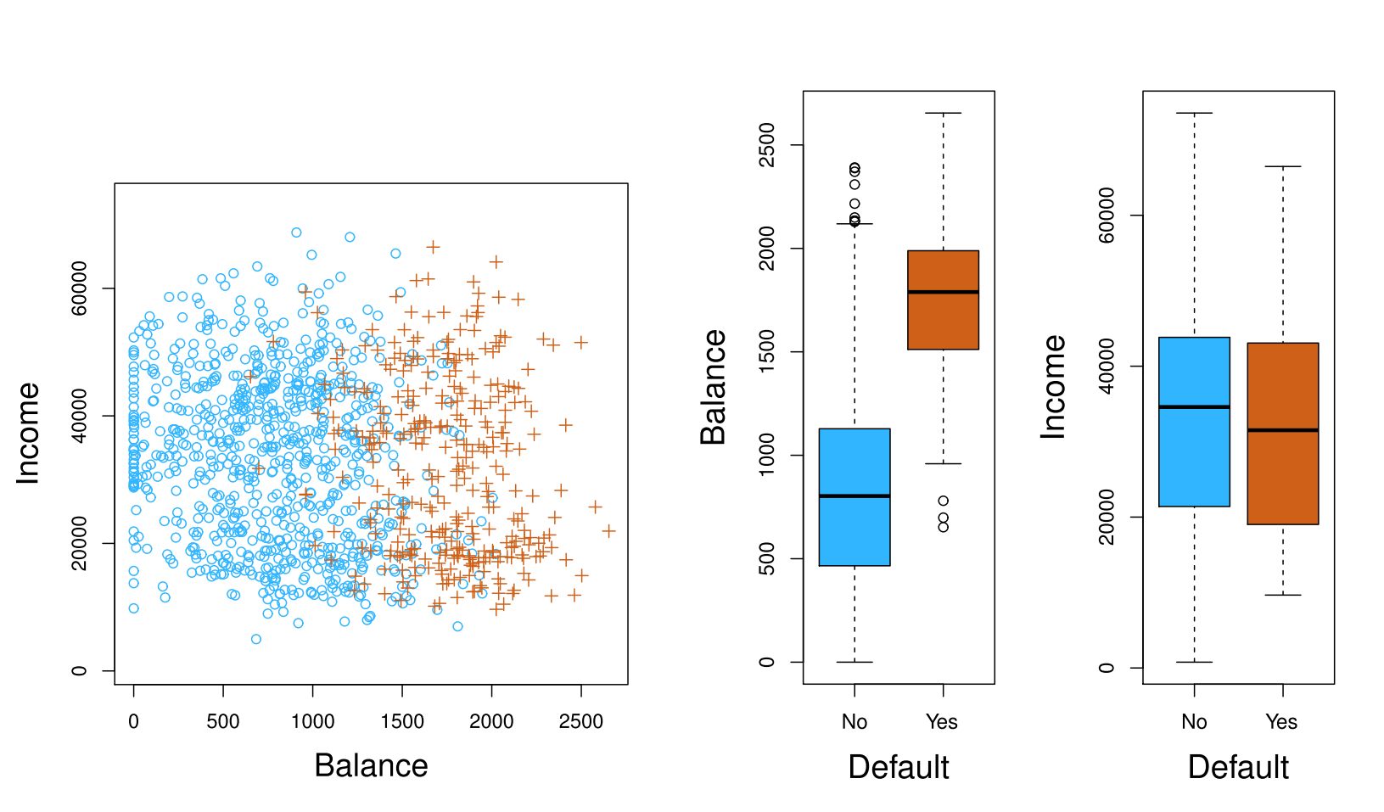

Example: Predicting Default

Slide 4
Example: Predicting Default

Slide 5
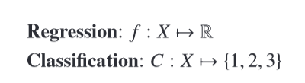
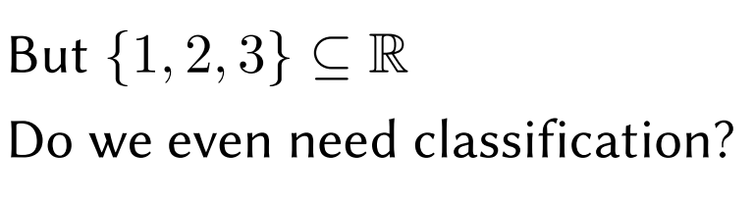
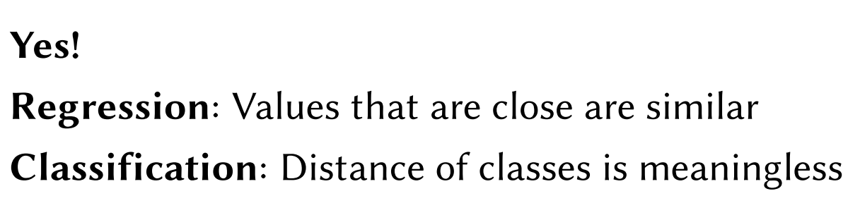
Can we use regression?

Slide 6
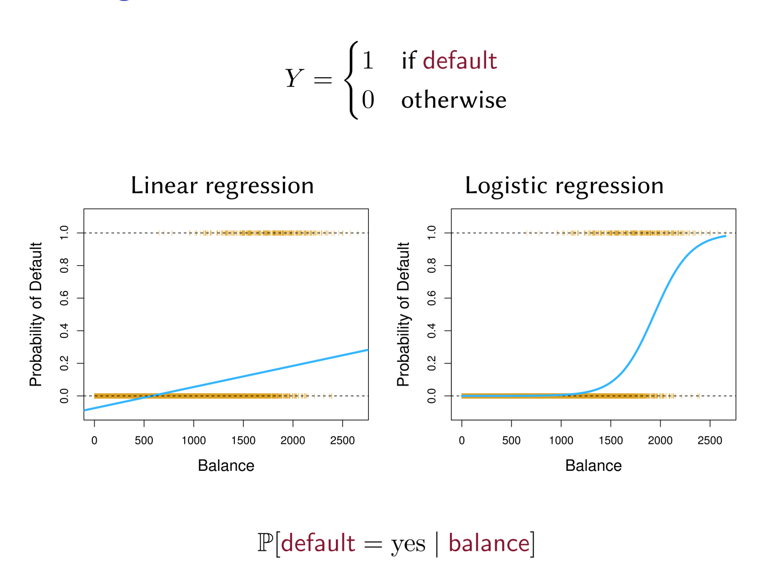
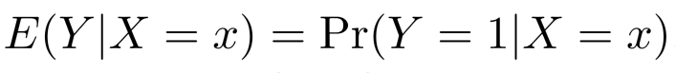
Linear Regression for 2-class Classification ?

Slide 7
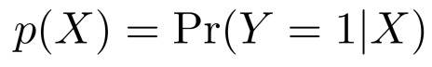
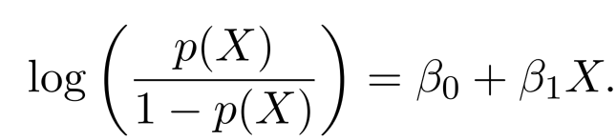
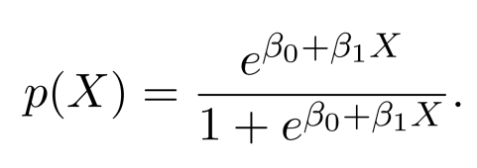
Logistic Regression
Let . How can we turn this to something range of a real line?
This monotone transformation is call the log odds or logit
Logistic regression uses the form

Slide 8
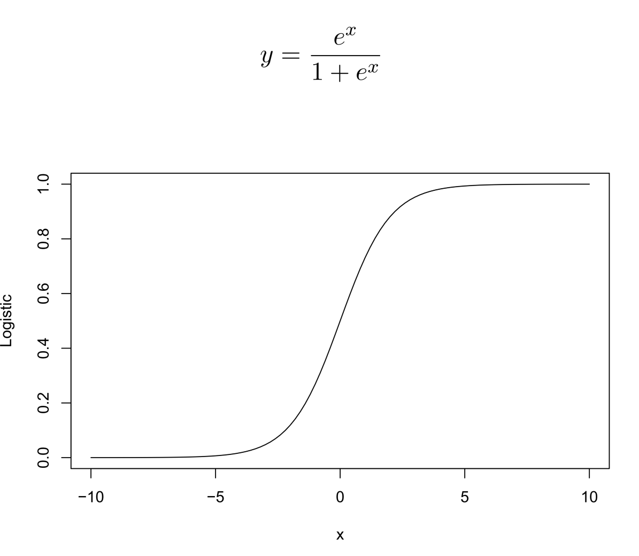
Logistic Function

Slide 9
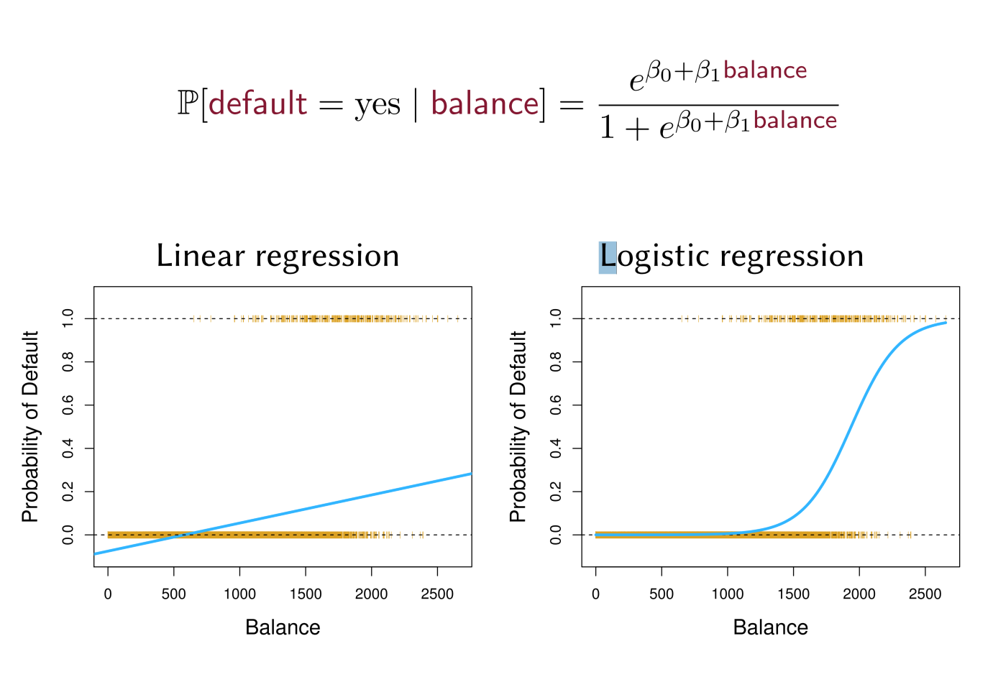
Logistic Regression

Slide 10
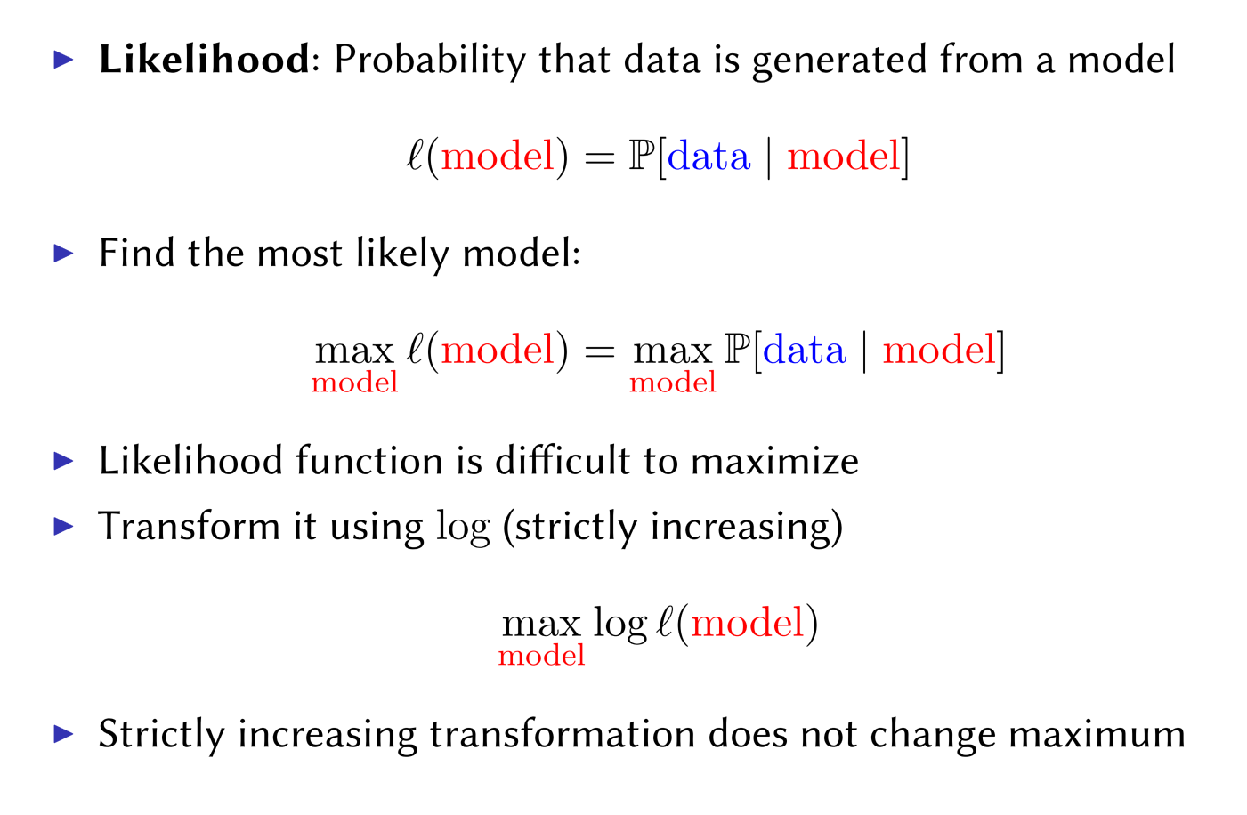
Estimating Coefficients: Maximum Likelihood

Slide 11
Estimating Coefficients: Maximum Likelihood

Slide 12
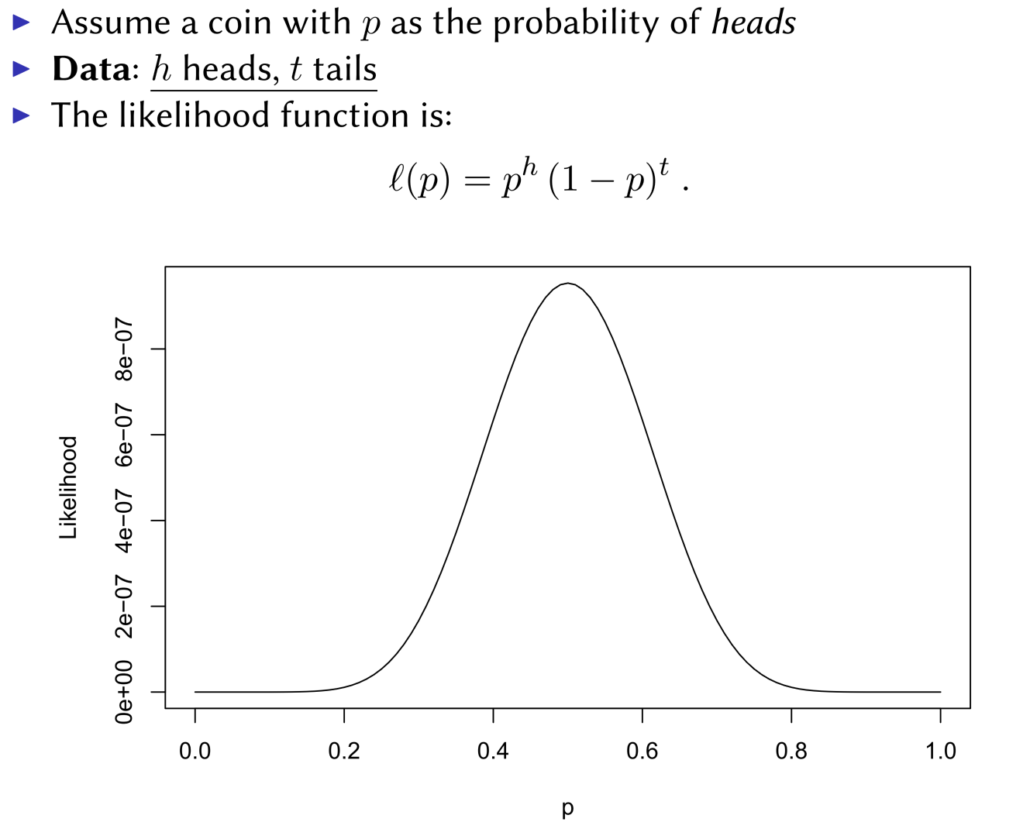
Maximum Likelihood

Slide 13
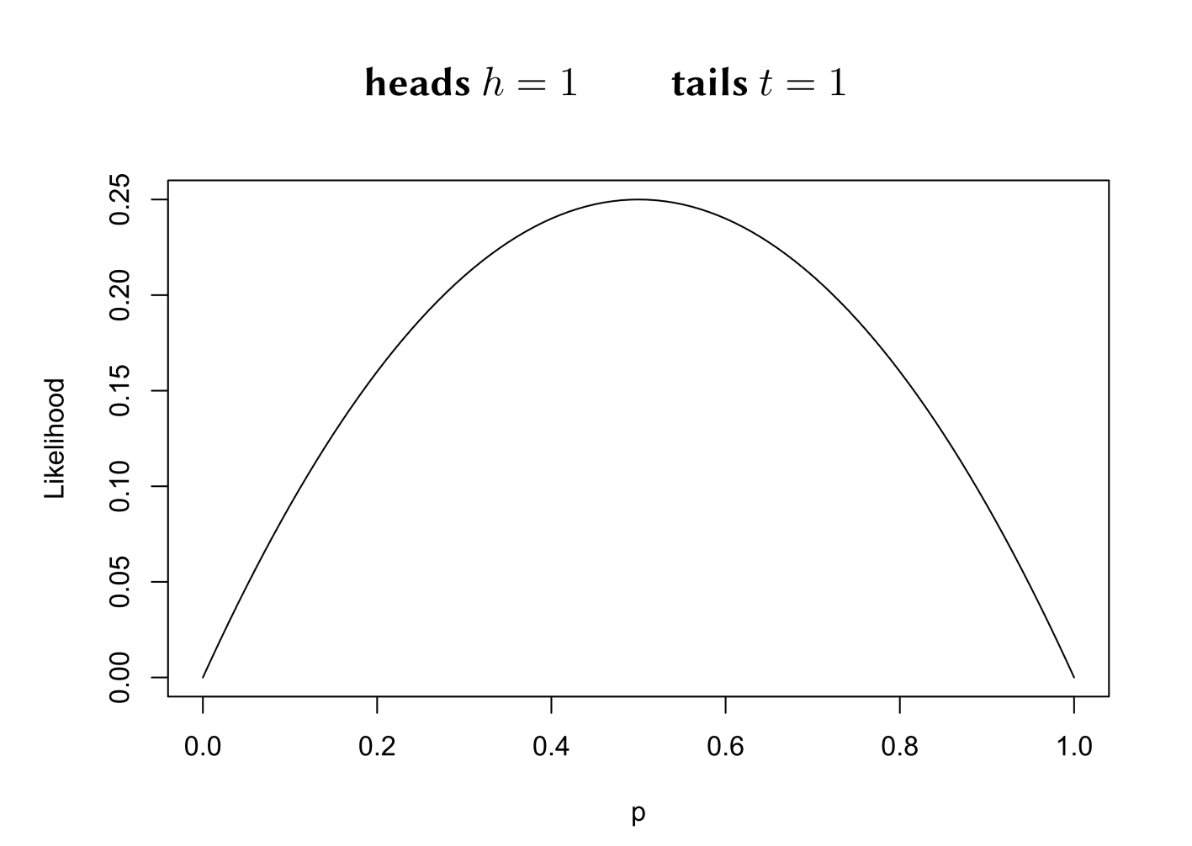
Maximum Likelihood

Slide 14
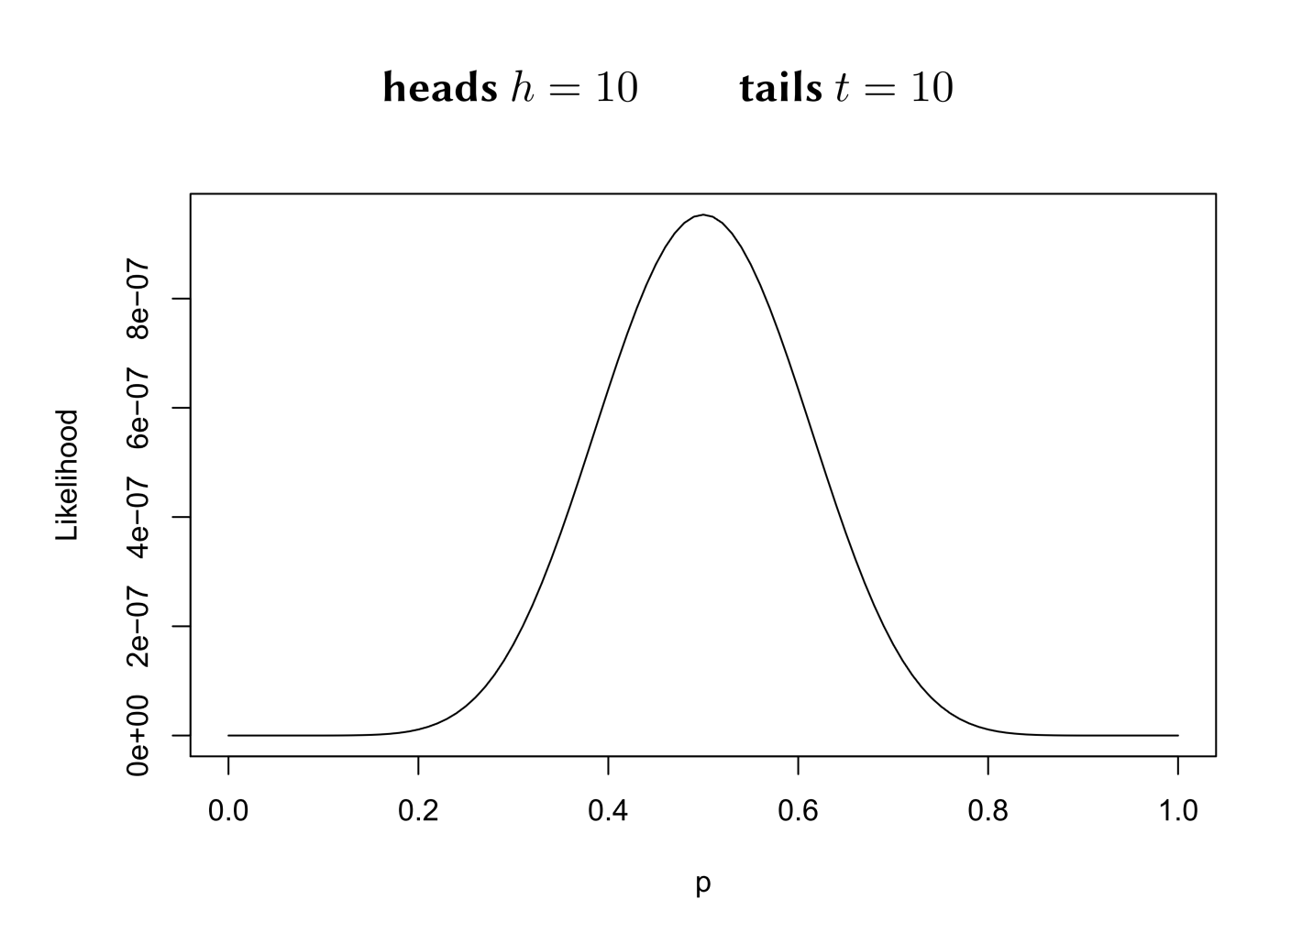
Maximum Likelihood

Slide 15
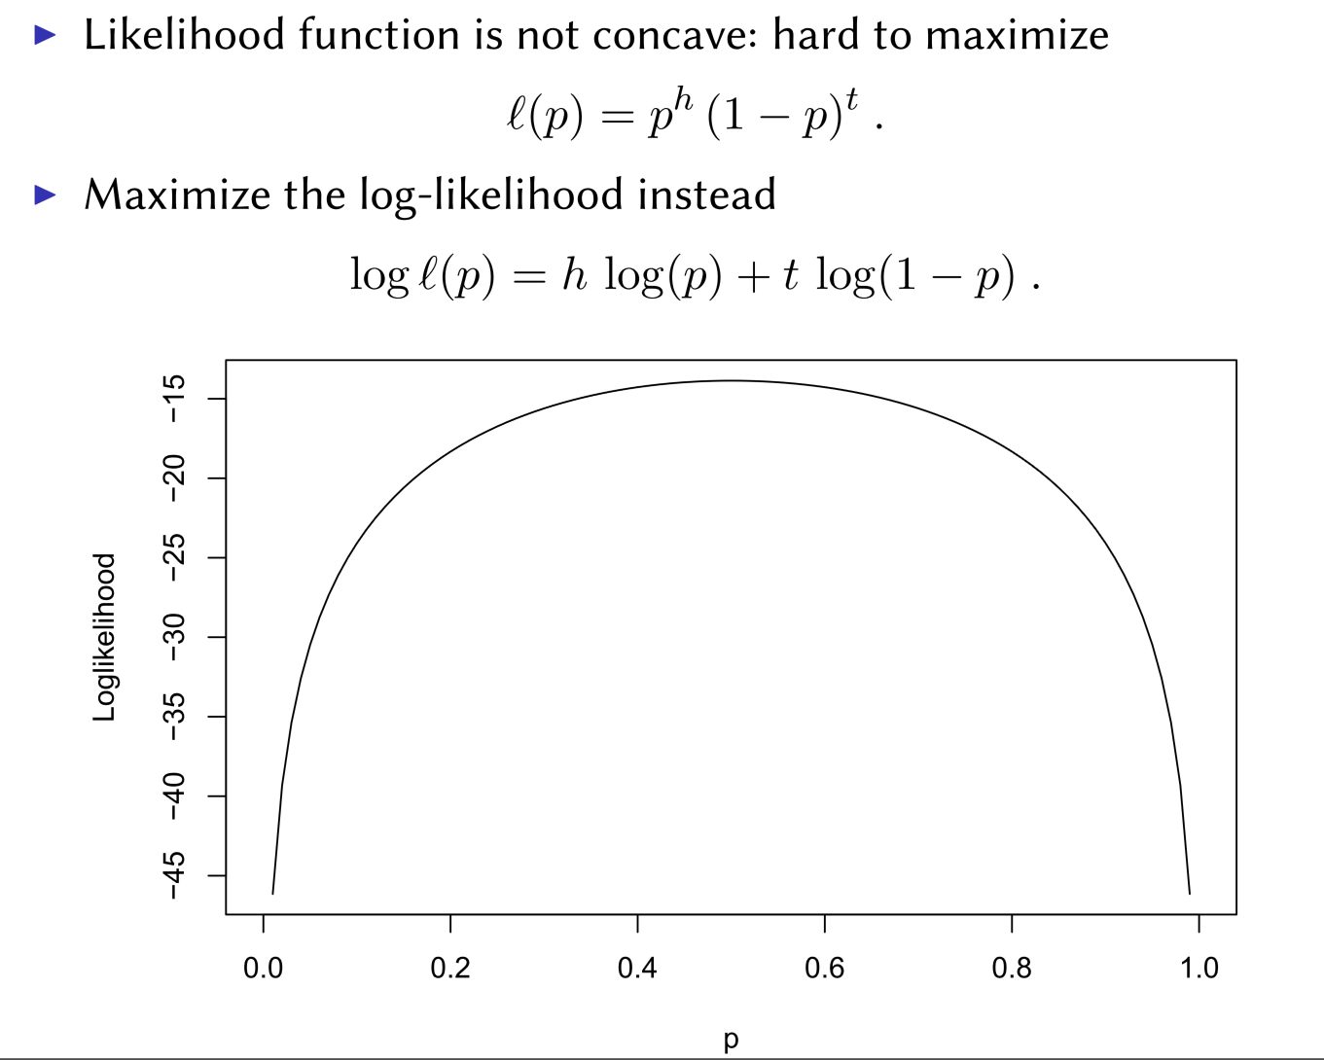
Maximum Likelihood

Slide 16
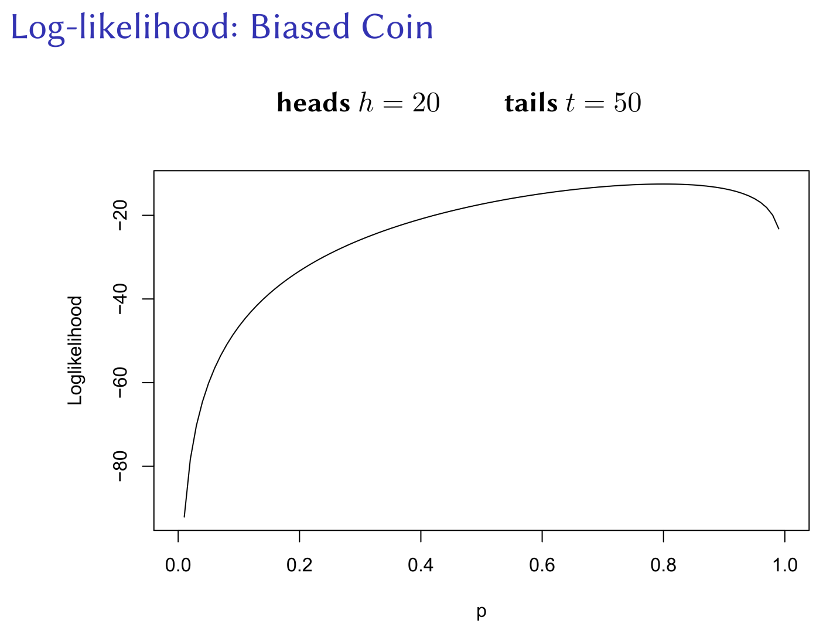

Slide 17
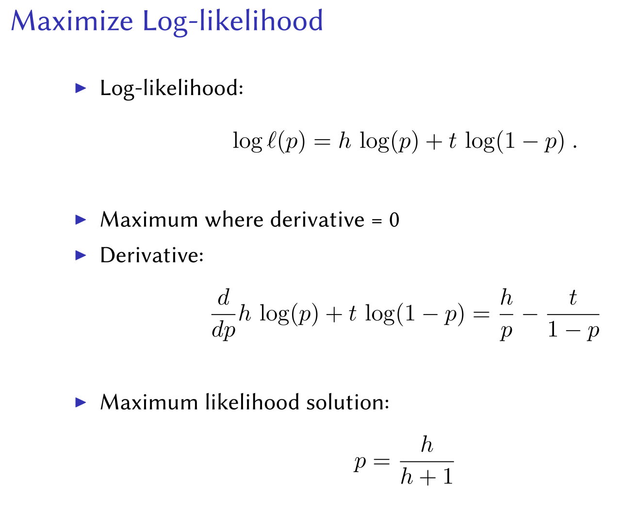

Slide 18
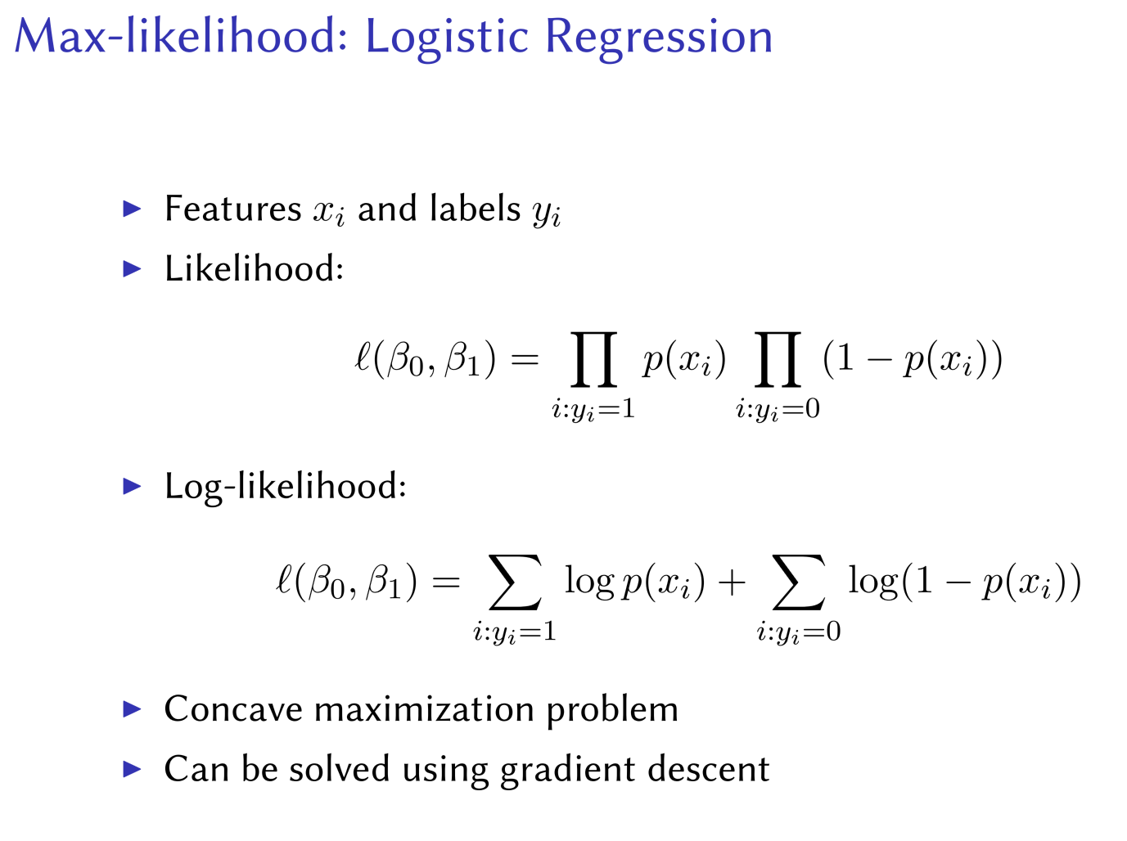

Slide 19
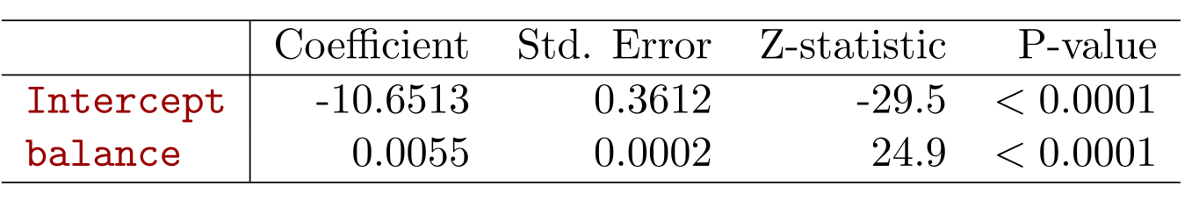
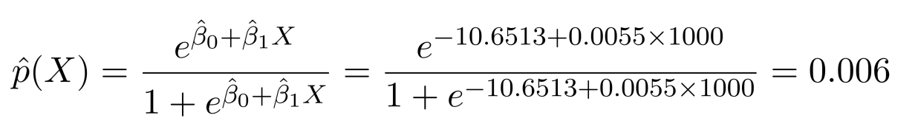
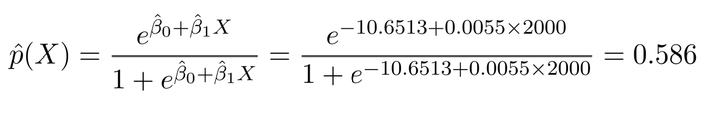
Maximum Likelihood: Default Example
What is the estimated probability of default for someone with a balance of $1000?
With a balance of $2000?

Slide 20
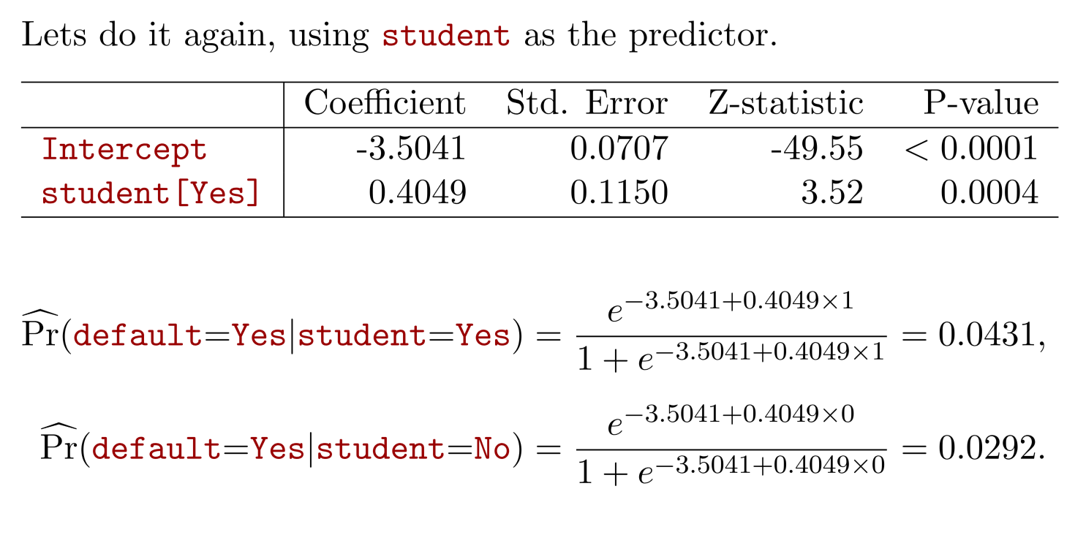
Maximum Likelihood: Default Example

Slide 21
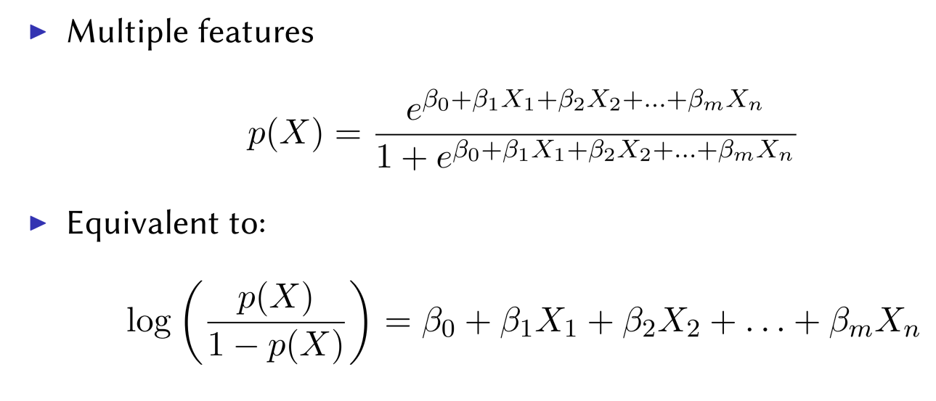
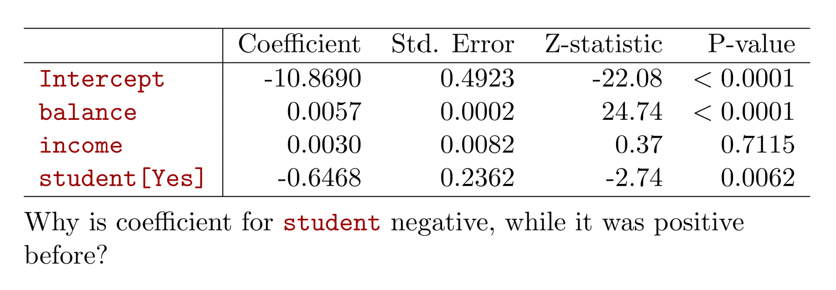
Multiple Logistic Regression

Slide 22
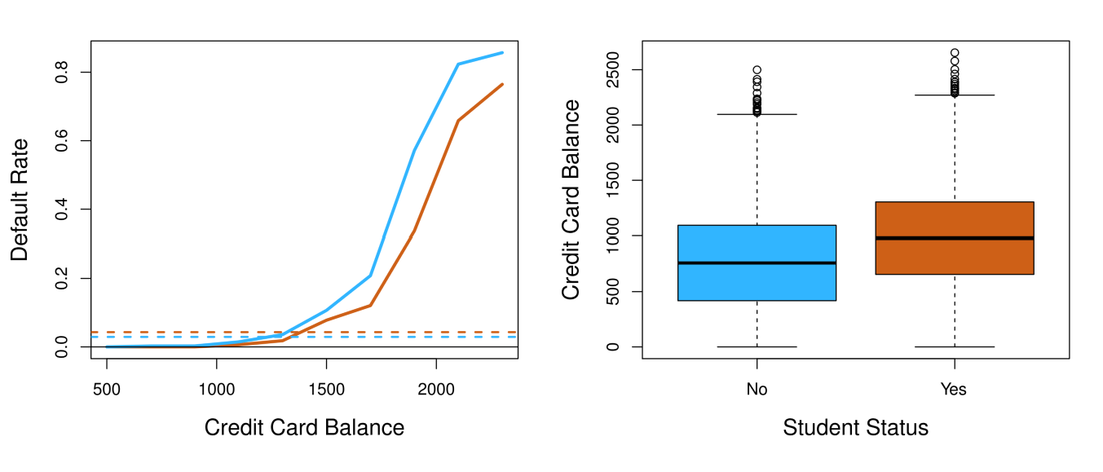
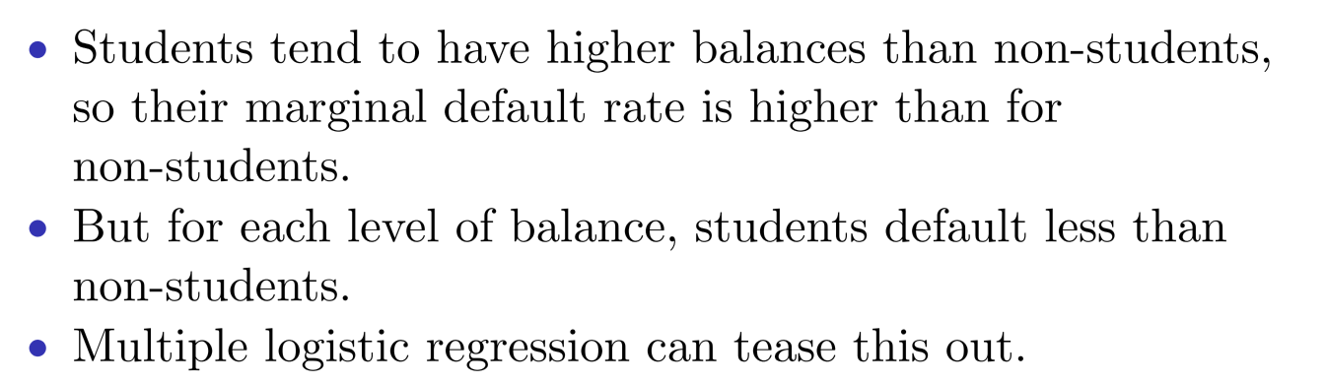
Confounding

Slide 23
Example: Heart Disease
160 cases of MI (myocardial infarction) and 302 controls (all male in age range 15-64), from Western Cape, South
Measurements on seven predictors (risk factors), shown in scatterplot matrix.
Goal is to identify relative strengths and directions of risk factors

Slide 24
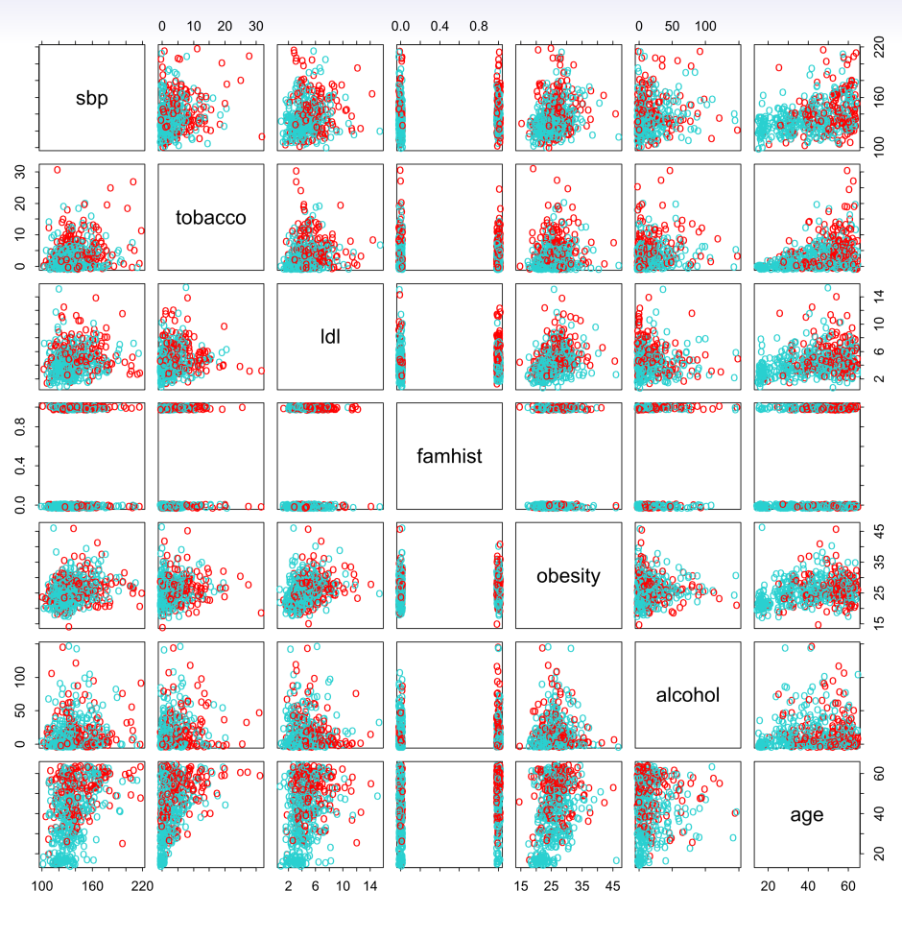
Example: Heart Disease

Slide 25
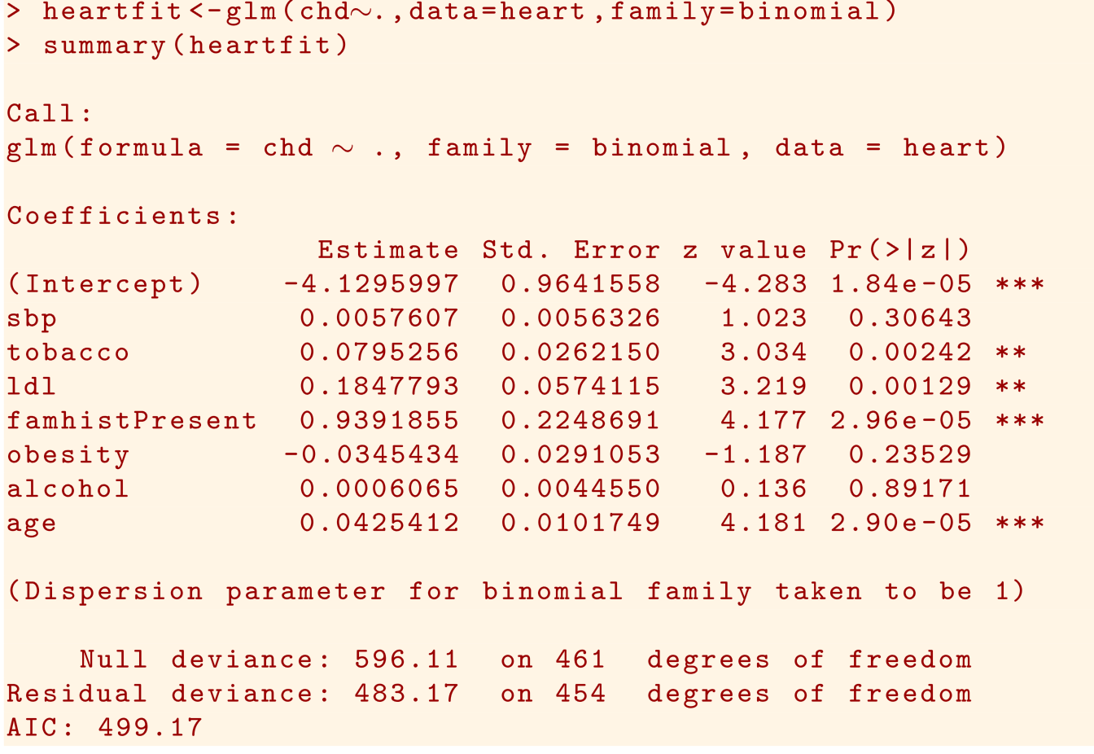
Example: Heart Disease

Slide 26
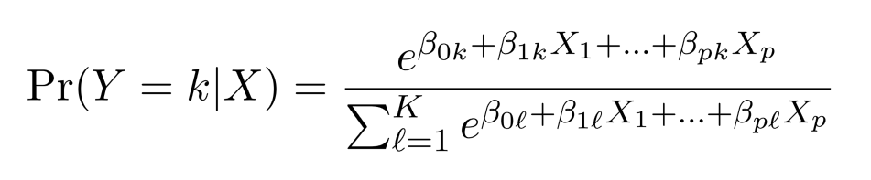
Logistic Regression with more two classes
There is a linear function for each class
This is a softmax function.
Not recommended

Slide 27
Linear Discriminant Analysis (LDA)
Model the distribution of X in each of the classes separately, and then use Bayes theorem to obtain Pr(Y |X).
If we assume Gaussian (Normal) distribution for P(X|Y) , we will have linear or quadratic discriminant analysis
Can be extended to other distributions.

Slide 28
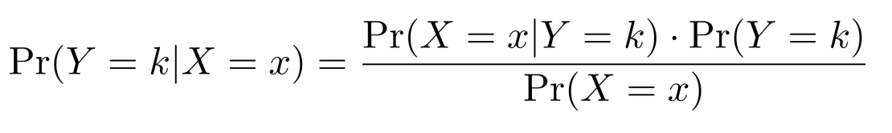
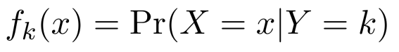
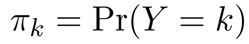
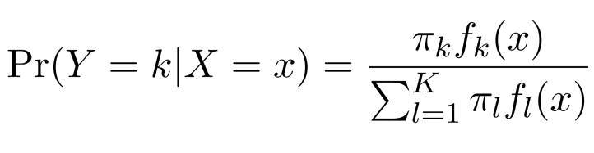
Bayes Theorem
Bayes Theorem
Let be the density for X in class k.
Let be the marginal or prior probability for class k.
We then have

Slide 29
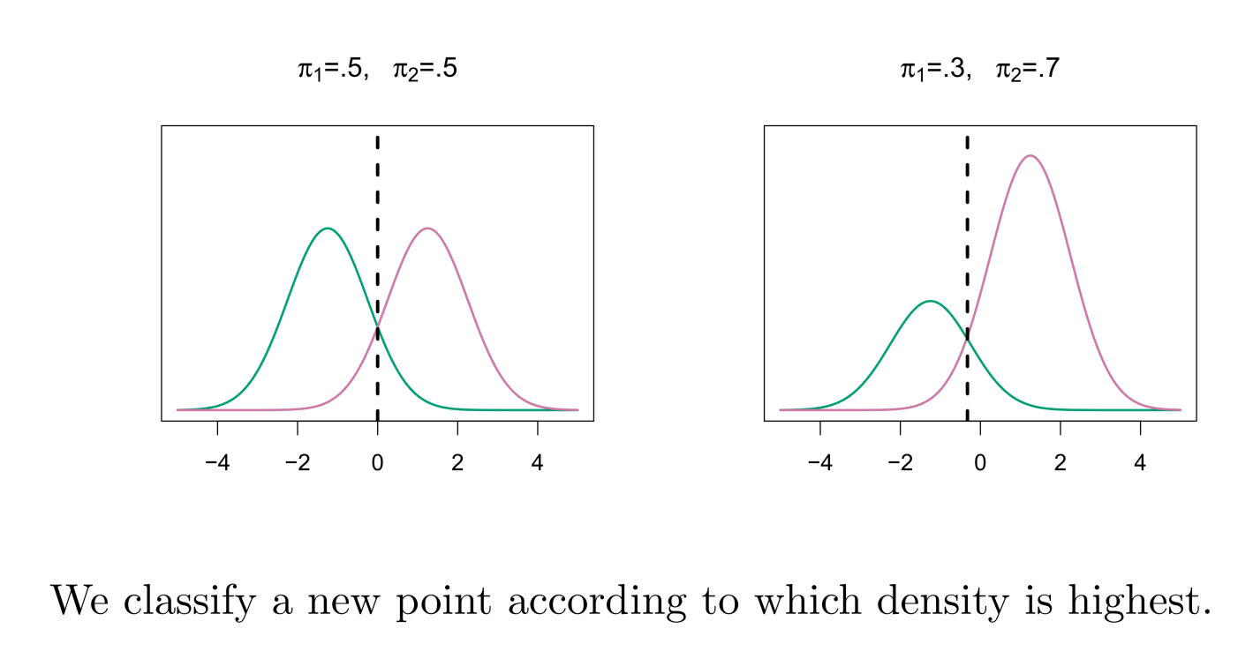
Classify to the Highest Weighted Density

Slide 30
Why Discriminant Analysis
When classes are well-separated, the parameter estimates for the logistic regression are unstable.
LDA is more stable if the assumption of Normality is correct.
LDA works well when K > 2.

Slide 31
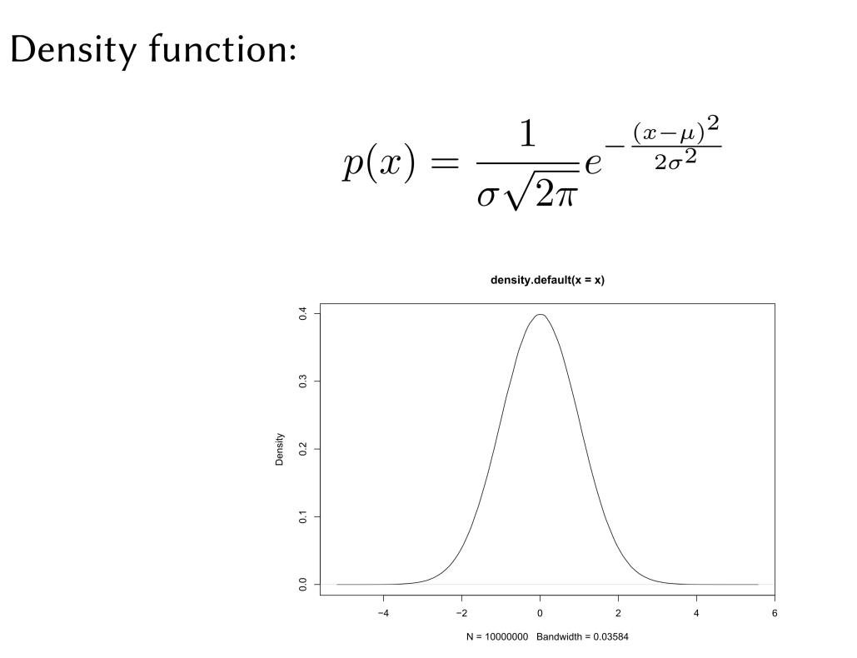
Gaussian Distribution

Slide 32
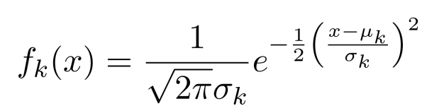
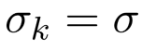
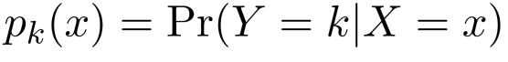
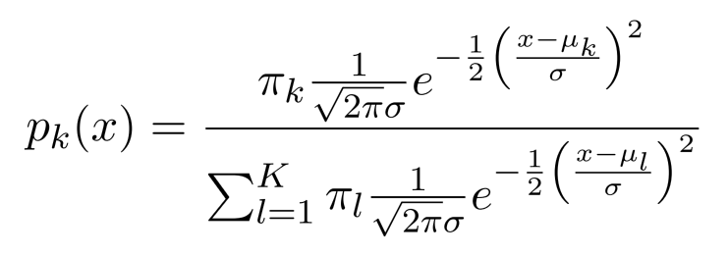
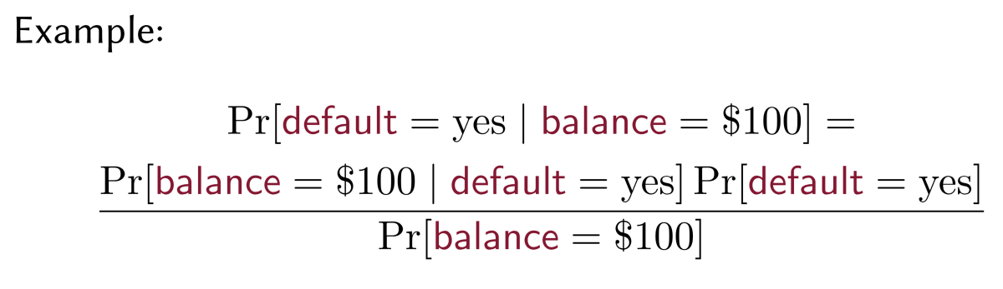
LDA when p = 1
Under Gaussian assumption, we have
The key assumption we will make: for all k.
We then can write :

Slide 33
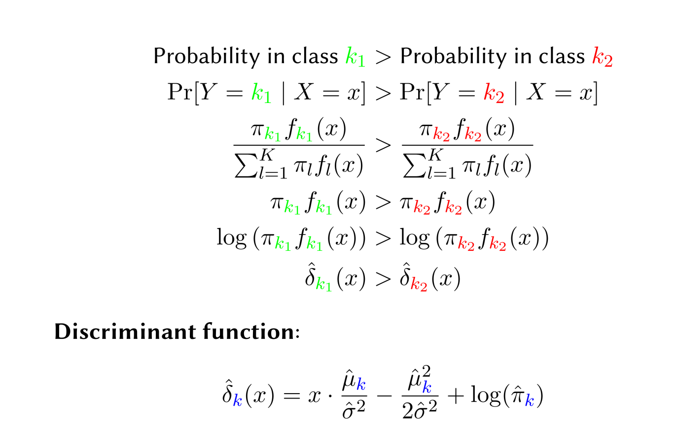
LDA when p = 1

Slide 34
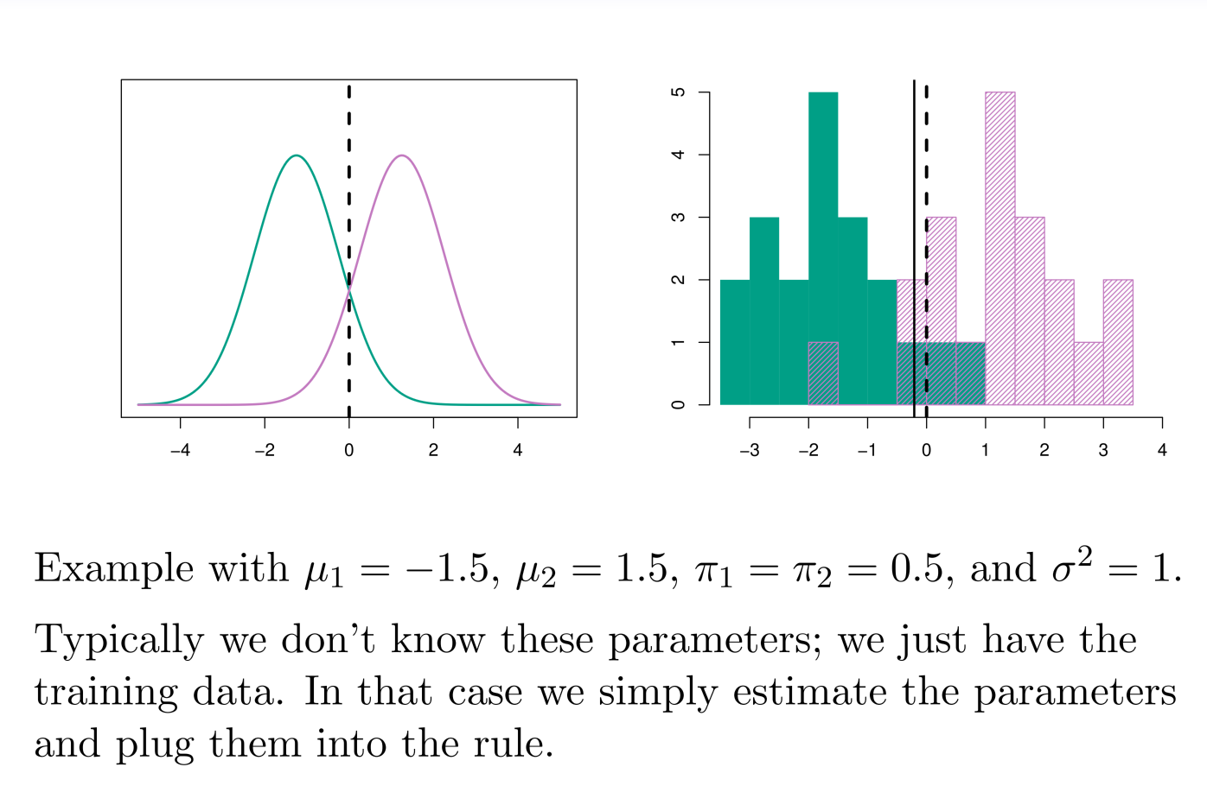
LDA when p = 1

Slide 35
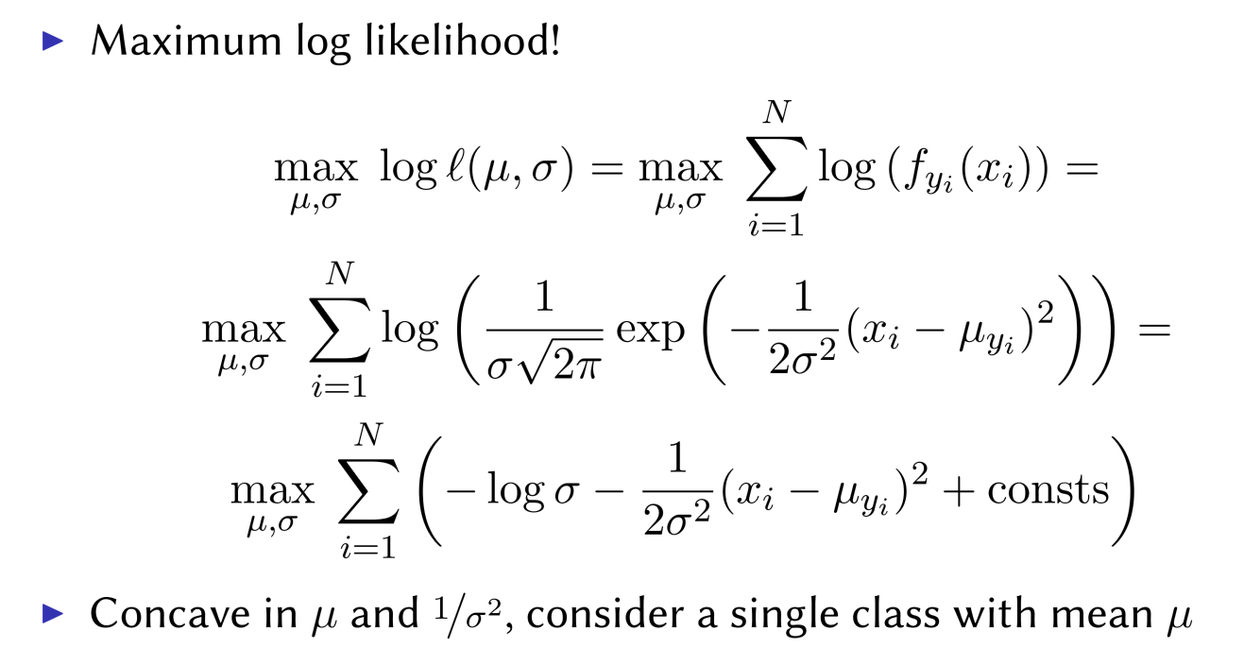
Estimating LDA Parameters

Slide 36
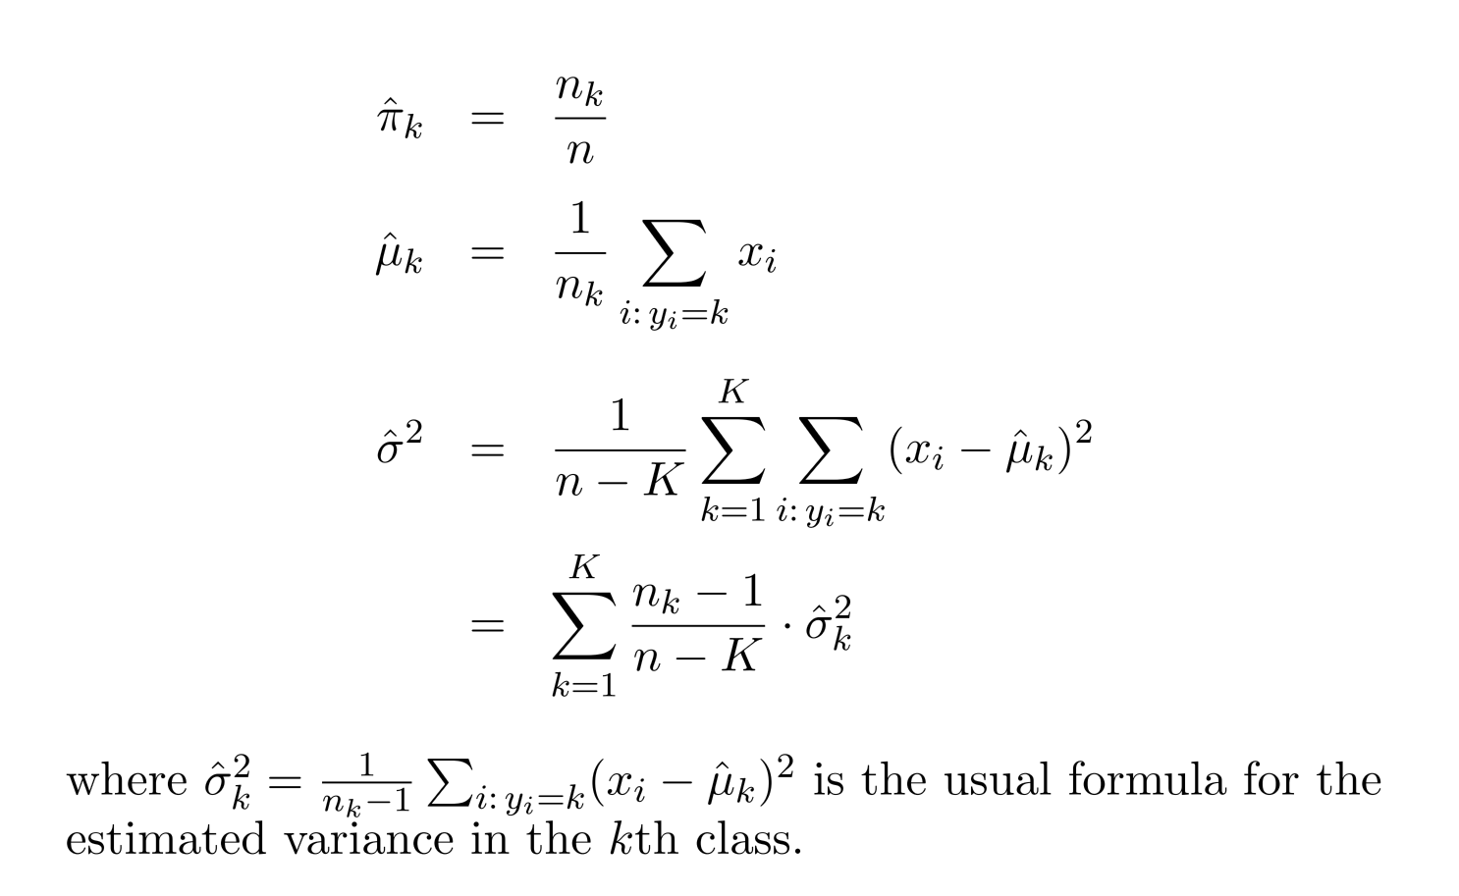
Estimating LDA Parameters

Slide 37
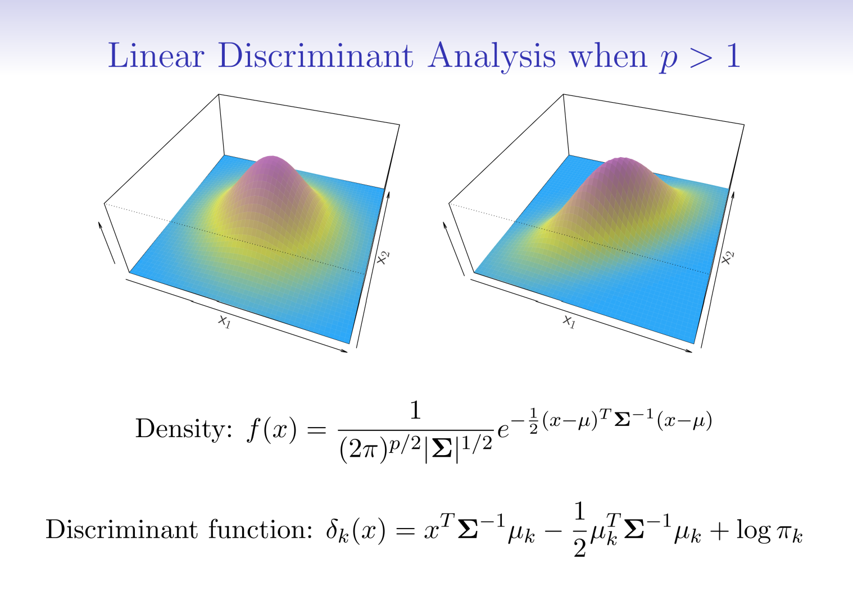
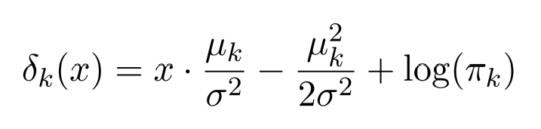
LDA with Multiple Features

Slide 38
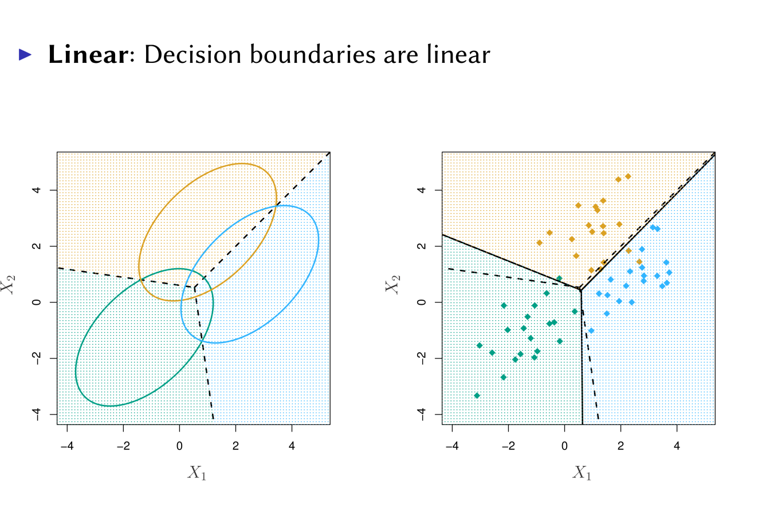
Multivariate Classification

Slide 39
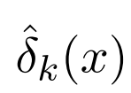


How to get Probability?
After estimating , how to turn it into probability?
Classifying to the largest amounts to classifying to the class for which is largest.

Slide 40

Confusion Matrix: Predict default

Slide 41

Increasing LDA Sensitivity
0.2

Slide 42

False Positive rate: FP/(TN + FP) Type I error
True Positive rate (Recall, sensitivity): TP/ (TP + FN) 1 – Type II error

Slide 43

Area Under the ROC Curve (AUC)

Slide 44


Other Forms of Discriminant Analysis
Gaussian + same covariance matrix for each class → LDA
Gaussian + different covariance matrix for each class → Quadratic Discriminant Analysis (QDA)
Assume features are independent, we get naïve Bayes.

Slide 45

QDA

Slide 46

QDA

Slide 47


Naïve Bayes
When p is large, LDA and QDA will break down.
Assume features are independent in each class.
Gaussian Naïve Bayes assumes each is diagonal

Slide 48

Logistic Regression versus LDA
When K > 2, we prefer LDA
When K = 2, we can show that for LDA
So it has the same form as logistic regression
The difference is in how the parameter are estimated.
They are very similar.

Slide 49

Comparisons
p = 2; K = 2; n = 20 for each class
Data within each class follow Gaussian distribution with a different mean in each class and same covariance matrix.
KNN-1, KNN-CV, LDA, Logistic, QDA

Slide 50

Comparisons
p = 2; K = 2; n = 20 for each class
Data within each class follow t-distribution with a different mean in each class and same covariance matrix.
KNN-1, KNN-CV, LDA, Logistic, QDA

Slide 51

Comparisons
p = 2; K = 2; n = 20 for each class
Data within each class follow a Gaussian distribution with a different mean and a different covariance matrix in each class.
KNN-1, KNN-CV, LDA, Logistic, QDA

